Slide 1
CONTRACT LIFECYCLE MANAGEMENT
By-Ledroit india team

Slide 2
CAREER IN CLM

Slide 3
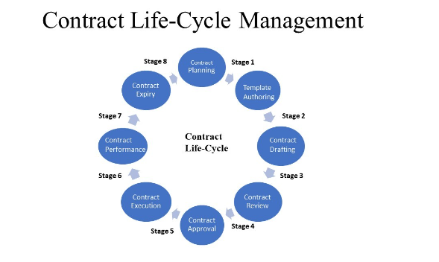

Slide 4
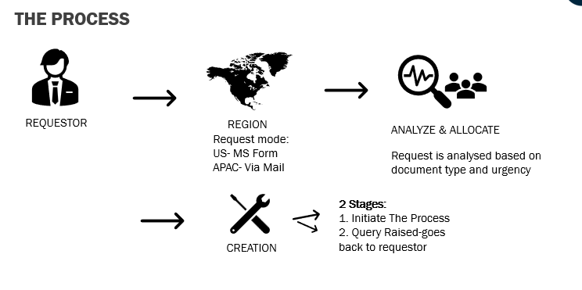

Slide 5
